Slide 1

WHAT IS
DATABASE?
A database is an organized collection of data stored and managed electronically to provide access, retrieval, and management of data. Think of it as a digital filing cabinet, but instead of paper files, you have electronic records.

Slide 2
The primary purpose of a database is to efficiently store, manage, and retrieve data.
This allows:
Data Organization: Arranging data in a logical and accessible manner.
Data Integrity: Ensuring data accuracy and consistency.
Data Security: Protecting data from unauthorized access.
Data Sharing: Enabling multiple users to access and utilize the same data.
Data Analysis: Supporting decision-making through data processing and analysis.
PURPOSE

Slide 3
RDBMS
(Rational Database Management System)
TYPES
OF
DATABASE
No- SQL (No sequel )

Slide 4
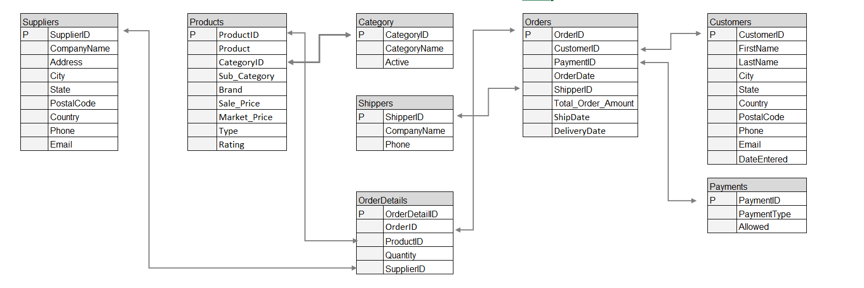
Relational Databases (RDBMS):
Structure: Data is organized into tables with rows and columns.
Relationships: Data between tables is linked using relationships (primary and foreign keys).
Query Language: SQL (Structured Query Language) is used to interact with the database.
Examples: MySQL, PostgreSQL, Oracle Database, Microsoft SQL Server.

Slide 5
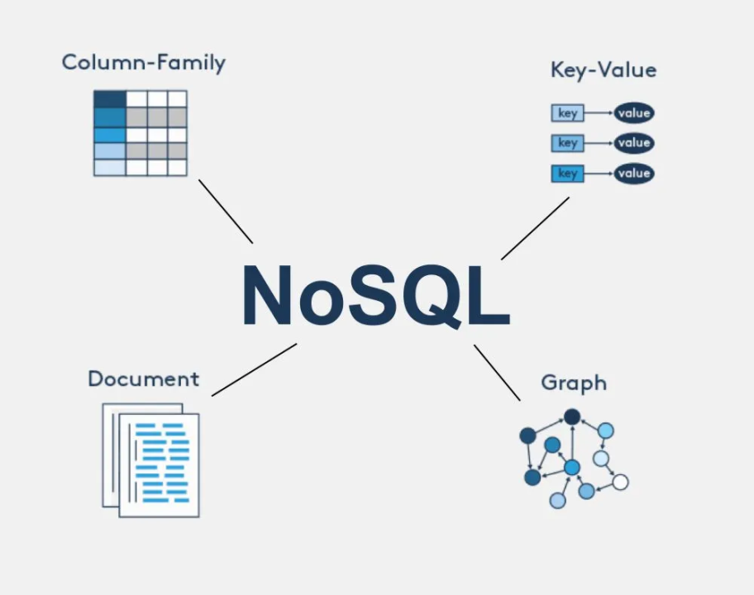
Non-Relational Databases (NoSQL)
Structure: More flexible data models like key-value, document, columnar, or graph.
Scalability: Designed to handle large volumes of data and high traffic.
Flexibility: Accommodates diverse data types and structures.
Examples: MongoDB, Cassandra, Redis, Neo4j.

Slide 6

Relational Database
Non-Relational Database
Feature | Relational Database | Non-Relational Database
Structure | Rigid, predefined schema | Flexible, schema-less or dynamic
Scalability | Vertical scaling (adding hardware) | Horizontal scaling (adding more nodes)
Performance | Optimized for complex queries | Optimized for high read/write performance
Use Cases | Complex transactions, data integrity | Big data, real-time analytics, high volume data

Slide 7
Scalability Challenges
Vertical Scalability: Traditional relational databases (RDBMS) often rely on vertical scaling, which involves adding more power (CPU, RAM, storage) to a single server. This approach has physical and financial limitations.
Horizontal Scalability: RDBMS are less adept at horizontal scaling, which involves adding more servers to distribute the load. Maintaining consistency and managing distributed transactions across multiple nodes can be complex.
Data Volume: RDBMS can struggle with very large datasets. As data grows exponentially, the performance of read/write operations and the ability to back up and restore data efficiently can degrade.
LIMITATION OF RELATIONAL DATABASE

Slide 8
Flexibility Challenges
Schema Rigidity: RDBMS require a predefined schema, making it difficult to handle unstructured or semi-structured data. Any changes to the schema, such as adding a new column, can be disruptive and require downtime.
Complex Queries: While RDBMS excel at complex queries and transactions, they can become cumbersome when dealing with flexible or hierarchical data structures, such as JSON or XML, which require extensive mapping.
Data Types: The fixed schema design means that integrating new data types or changing existing ones is complex and time-consuming, limiting the flexibility to adapt to new requirements.
LIMITATION OF RELATIONAL DATABASE

Slide 9
Performance Challenges
High Read/Write Loads: RDBMS can suffer from performance bottlenecks under high read/write loads due to locking mechanisms and transaction management, which ensure data integrity but slow down performance.
Indexing and Joins: While indexing improves query performance, maintaining indexes can slow down write operations. Complex joins across large tables can also significantly degrade performance.
Concurrency: Managing concurrent access to data in an RDBMS involves locking mechanisms that can lead to contention, affecting performance and scalability.
LIMITATION OF RELATIONAL DATABASE

Slide 10
Introduction to Big Data and Its Impact on Database Design
1. Volume: The sheer amount of data generated every second is enormous. Traditional databases are not designed to handle such massive amounts of data efficiently.
2. Velocity: Data is generated at high speeds and needs to be processed quickly. This requires databases that can handle real-time data ingestion and processing.
3. Variety: Big Data comes in different formats—structured, semi-structured, and unstructured. Traditional databases are optimized for structured data, but Big Data includes text, images, videos, and more.
4. Veracity: The accuracy and quality of data can vary, and databases must be designed to deal with this uncertainty.
Big Data refers to the vast and rapidly growing volumes of data generated by various sources, such as social media, sensors, transactions, and more. This data is characterized by its Volume, Velocity, Variety, and sometimes Veracity—collectively known as the "4 Vs" of Big Data.

Slide 11
Impact on Database Design
The rise of Big Data has led to significant changes in how databases are designed and managed
Scalability: Traditional databases can’t handle huge amounts of data efficiently. New databases, like NoSQL, are designed to grow and handle large datasets by spreading data across multiple servers.
Distributed Storage: Instead of storing all data in one place, Big Data is often stored across multiple servers. This way, if one server fails, others can still keep the system running.
Flexible Design: Traditional databases require a fixed structure for data (like tables in a spreadsheet). But Big Data comes in different forms, so new databases allow more flexibility, letting you store different types of data together.
Real-Time Processing: Some applications need to process data as soon as it’s created. New databases are designed to handle this, allowing instant analysis and decision-making.
Data Lakes: Instead of organizing all data neatly, a data lake allows you to dump all types of data into one place. You can then sort and analyze it as needed.
Advanced Analysis: Big Data databases often have built-in tools for running complex analysis, making it easier to get insights from your data.

Slide 12
Impact on Database Design
The emergence of Big Data has significantly impacted database design and management. Traditional relational databases, while efficient for structured data, often fall short when dealing with the vastness, complexity, and velocity of Big Data.
Here are some key impacts:
Need for Scalability: Big Data demands databases that can handle exponentially growing datasets without compromising performance. This has led to the development of distributed databases and cloud-based solutions.
Flexibility and Schema-less Design: The diverse nature of Big Data requires databases that can accommodate different data formats and structures without rigid schemas. NoSQL databases have gained popularity due to their flexibility.
Real-time Processing: Many Big Data applications require real-time insights. Databases need to be designed to handle high ingestion rates and provide low-latency query responses.
Cost-Effective Storage: Storing massive amounts of data can be expensive. Databases must optimize storage utilization and leverage cost-effective storage options.
Data Governance and Security: With increasing data volumes, ensuring data quality, security, and compliance becomes critical. Databases need robust governance and security features

Slide 13
Introduction to NoSQL
NoSQL (Not Only SQL) is a type of database that is designed to handle large amounts of data in a flexible and scalable manner. Unlike traditional relational databases (which use SQL), NoSQL databases do not follow a rigid schema. This makes them more adaptable to changing data structures and can improve performance for certain types of applications.
Origins of NoSQL
The emergence of NoSQL databases can be traced back to the early 2000s. As the volume of data generated by web applications and other sources grew exponentially, traditional relational databases began to struggle with scalability and performance. NoSQL databases were developed to address these limitations.
Some of the factors that contributed to the rise of NoSQL include:
Scalability: NoSQL databases are designed to scale horizontally, meaning they can be easily distributed across multiple servers to handle large datasets.
Flexibility: NoSQL databases do not require a fixed schema, making them more adaptable to changing data requirements.
Performance: NoSQL databases can often offer better performance than relational databases for certain types of workloads, such as real-time analytics and high-volume data processing.

Slide 14
Relationship to SQL
While NoSQL databases differ from relational databases in their structure and approach, they are not mutually exclusive. In many cases, organizations use a combination of NoSQL and relational databases to meet their specific data management needs.
Key differences between NoSQL and SQL databases:
Schema: NoSQL databases are schema-less or dynamically-schema'd, while relational databases require a predefined schema.
Data structure: NoSQL databases can store data in various formats, such as key-value pairs, document structures, or graph models. Relational databases typically use tables and rows.
Query language: NoSQL databases often use specialized query languages or APIs, while relational databases use SQL.

Slide 15
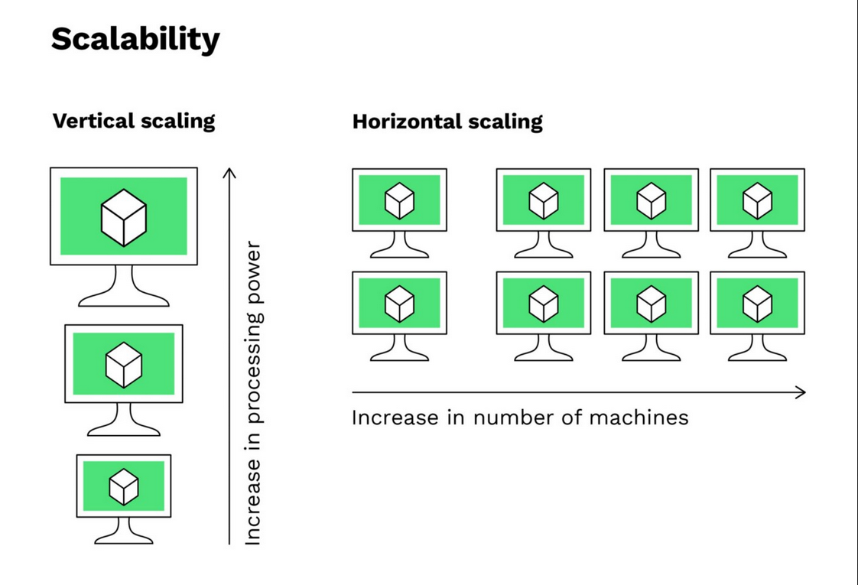

Slide 16
Why NoSQL
In the case of a Relational Database:- when you deal with a huge amount of data the system response time becomes slow.
To Overcome this problem we need to “scale up” our system by upgrading our existing hardware.
Vertical Scaling: When new resources are added to the existing system to meet the expectation, it is known as vertical scaling.
Consider a rack of servers and resources that comprises the existing system. Now when the existing system fails to
meet the expected needs, and the expected needs can be met by just adding resources, this is considered vertical scaling.
Vertical scaling is based on the idea of adding more power(CPU, RAM) to existing systems, basically adding more resources.
The alternative to this issue is to distribute the database Load on multiple hosts, this method is known as “Scaling Out”.
horizontal scaling involves adding more machines or nodes to a system.

Slide 17
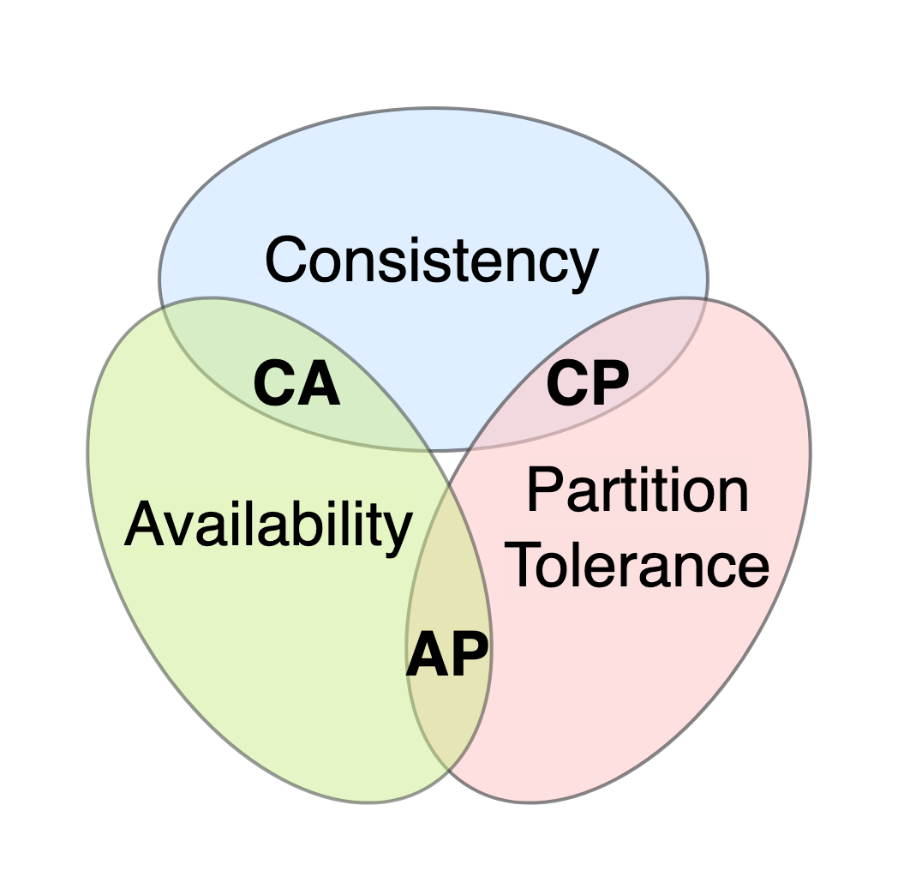
CAP Theorem:
The CAP theorem is a fundamental principle in distributed computing that states that it is impossible for a distributed system to simultaneously guarantee all three of the following properties:
Consistency: All nodes in the system see the same data at the same time.
Availability: The system is always available for read and write operations.
Partition Tolerance: The system continues to operate in the presence of network partitions.

Slide 18
Here's a breakdown of each property:
Consistency:
Strong Consistency: All replicas of a data item are always in agreement.
Eventual Consistency: Data will eventually be consistent across all replicas, but there may be temporary inconsistencies during updates.
Availability: Every request to a non-failing node in the system should receive a response, even if some nodes are down or experiencing network issues.
Partition Tolerance: The system should continue to operate even if there are network partitions or communication failures between nodes.
Examples of common trade-offs:
CA (Consistency and Availability): This is often used in systems where strong consistency is essential, such as financial systems. However, it can be challenging to achieve in large-scale distributed systems.
AP (Availability and Partition Tolerance): This is often used in systems that prioritize high availability, such as web services. However, it may result in eventual consistency.
CP (Consistency and Partition Tolerance): This is often used in systems that prioritize strong consistency but can tolerate some downtime during network partitions.

Slide 19
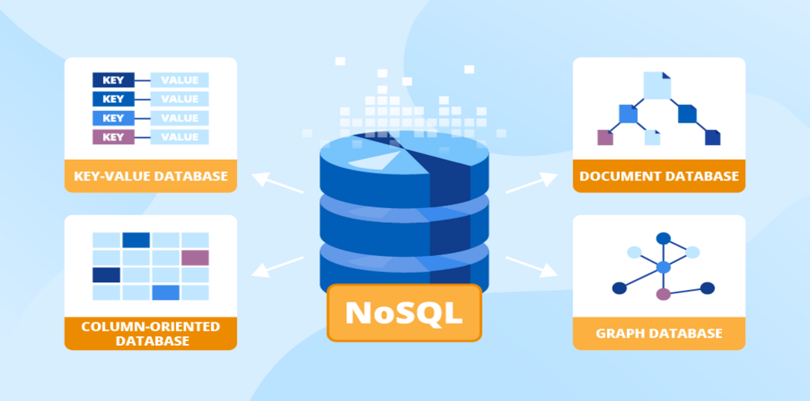
NoSQL Data Models

Slide 20
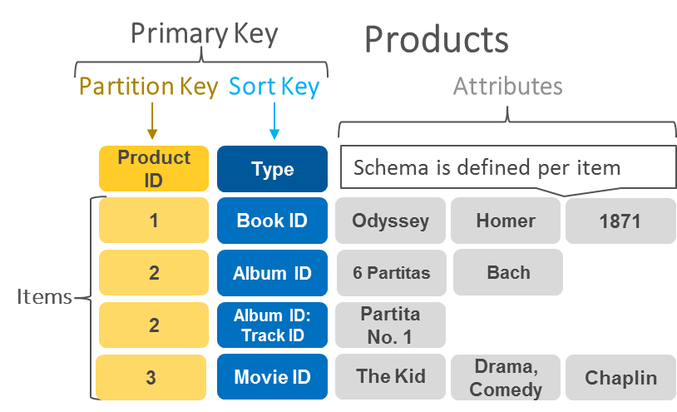
Key-Value Stores :
Key-value stores are a type of NoSQL database that store data as key-value pairs. This means that each piece of data is associated with a unique identifier (key), and the data itself is stored as a value. Think of it like a dictionary where each word (key) has a corresponding definition (value).
Key: A unique identifier that is used to access the corresponding value.
Value: The actual data associated with the key. The value can be of any data type, including strings, numbers, lists, sets, or even complex data structures.
Simplest NoSQL model, where data is stored as key-value pairs.
Extremely fast for read and write operations.
Well-suited for caching, session management, and storing user preferences
Examples: Redis, Amazon DynamoDB, Riak.

Slide 21
Use Cases:
Caching: Key-value stores are excellent for caching frequently accessed data, as they provide fast read and write operations.
Session management: Storing user session data to maintain state across requests.
Counters: Implementing counters for various purposes, such as tracking website visitors or product inventory.
Leaderboards: Storing high scores or rankings for games or competitions.
Real-time analytics: Processing and analyzing data in real-time for applications like IoT and financial systems.

Slide 22
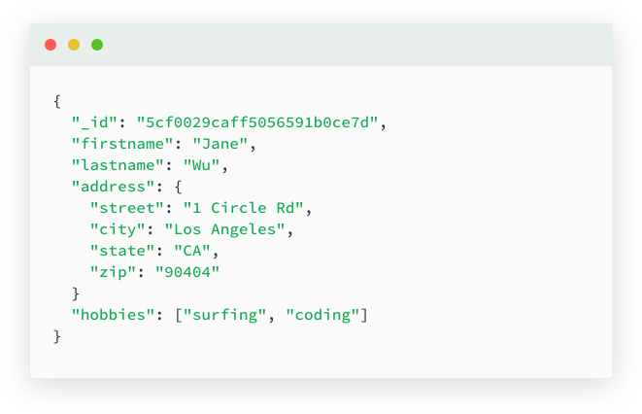
Document-Oriented Databases
Document-oriented databases store data in a flexible, JSON-like format, making them well-suited for semi-structured and unstructured data. Unlike relational databases that use tables and rows, document databases store data as individual documents.
Data is stored as JSON-like documents or BSON (binary JSON) objects.
Each document can have different fields and structures, providing flexibility.
Allows nesting of documents and arrays for more complex data representation.
Well-suited for Big Data , analytics.
Examples: MongoDB, Couchbase, CouchDB.

Slide 23
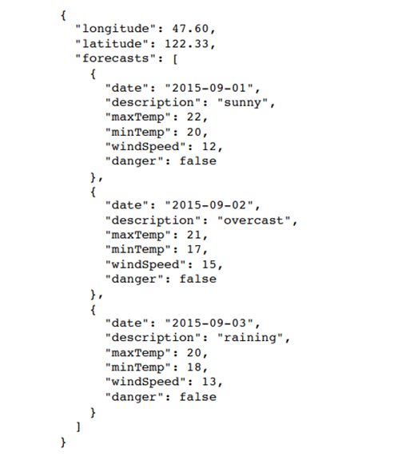
JSON and BSON Formats:
JSON (JavaScript Object Notation): A lightweight data-interchange format that uses key-value pairs to represent data. It's widely used in web development and APIs.

Slide 24
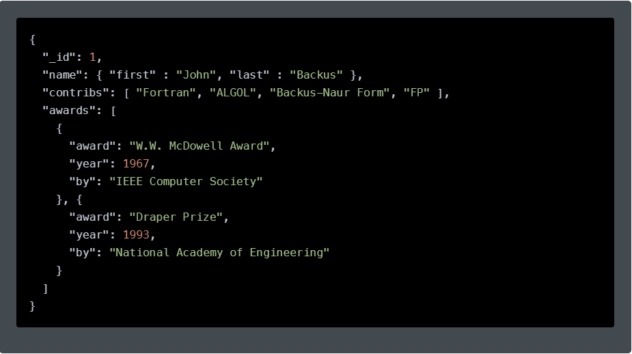
BSON (Binary JSON): A binary-encoded format that is similar to JSON but offers performance advantages and supports additional data types, such as binary data and date/time objects.

Slide 25
Use Cases:
Content management systems: Storing and managing documents, articles, and other content.
Web applications: Building dynamic and scalable web applications with complex data structures.
Mobile applications: Storing and retrieving data for mobile apps, such as user profiles and preferences.
IoT (Internet of Things): Processing and analyzing data from IoT devices.
Real-time analytics: Analyzing data in real-time for applications like customer behavior analysis.

Slide 26
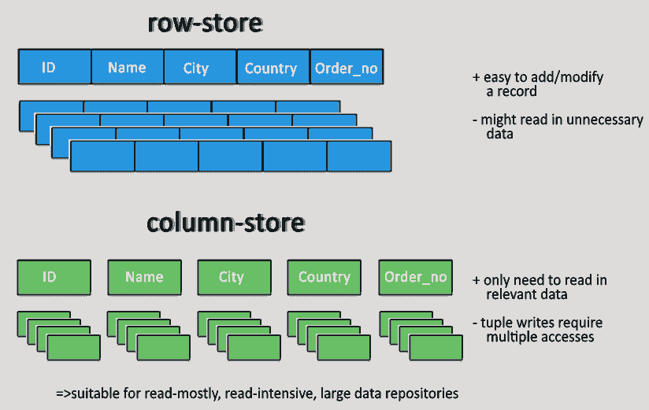
Columnar Databases
Columnar databases store data in columns, rather than rows like traditional relational databases. This means that all values for a specific column are stored together, which can significantly improve query performance for certain types of workloads.
Column: A vertical collection of values for a specific attribute or property.
Row: A horizontal collection of values for a single entity or record.
We need to define the schema in advance(column family).
Data is stored in column families, which are similar to tables in a relational database.
Ideal for IOT, Big Data, analytics.
Examples: Apache Cassandra, HBase

Slide 27
Use Cases:
Data warehousing: Storing and analyzing large datasets for reporting and analytics.
Time series data: Storing and querying time-stamped data, such as sensor readings or financial data.
OLAP (Online Analytical Processing): Performing complex analytical queries on large datasets.
Data mining: Discovering patterns and trends in large datasets.

Slide 28
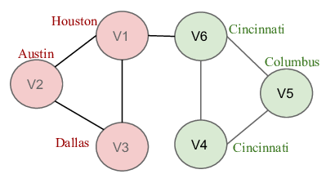
Graph Databases
Graph databases are a type of NoSQL database that store data as a graph, consisting of nodes (vertices) and edges (relationships). This makes them well-suited for representing data with complex relationships and networks.
Nodes, Edges, and Properties:
Nodes: Represent entities or objects in the graph.
Edges: Represent connections or relationships between nodes.
Properties: Key-value pairs associated with nodes and edges that store additional information
In this example, users are represented as nodes, and friendships are represented as edges. Each node might have properties like name, email, and age, while each edge might have properties like created_at and status.
Data is represented as nodes (entities) and edges (relationships) between nodes.
Designed to handle highly interconnected data and complex relationships.
Suitable for social networks, recommendation engines, and knowledge graphs.
Examples: Neo4j, Amazon Neptune

Slide 29
Use Cases:
Social networks: Modeling relationships between users, groups, and content.
Recommendation systems: Suggesting items or content based on user preferences and connections.
Fraud detection: Identifying patterns of fraudulent activity in networks.
Knowledge graphs: Representing knowledge and relationships between entities.
Network analysis: Analyzing networks to identify key players, clusters, and communities.

Slide 30
Advantages of NoSQL
Scalability:
Horizontal scaling: NoSQL databases can easily scale horizontally by adding more servers to handle increased workloads, making them suitable for large-scale applications.
Flexibility: NoSQL databases can handle unstructured or semi-structured data, making them adaptable to changing data requirements.
Performance:
Optimized for specific workloads: NoSQL databases are often optimized for specific workloads, such as real-time analytics or high-throughput data processing.
Reduced overhead: The schema-less or dynamically-schema'd nature of NoSQL databases can reduce overhead compared to relational databases
Cost-effectiveness:
Lower hardware requirements: NoSQL databases can often be more cost-effective than relational databases, especially for large-scale applications.

Slide 31
Specific Use Cases Where NoSQL Excels
Real-time analytics: Processing and analyzing large volumes of data in real-time, such as IoT data or financial data.
Content management systems: Storing and managing unstructured content, such as documents, images, and videos.
Mobile applications: Handling large amounts of user data and providing low-latency responses.
Gaming: Storing and processing game data, such as player profiles, game stats, and leaderboards.
Social networks: Managing large-scale social graphs and user interactions.

Slide 32
Disadvantages of NoSQL
Lack of ACID compliance:
Eventual consistency: Many NoSQL databases prioritize availability and partition tolerance over strong consistency, which can lead to data inconsistencies in certain scenarios.
Complex query capabilities: While NoSQL databases have improved query capabilities in recent years, they may still be less powerful than relational databases for complex joins, aggregations, and subqueries.
Potential data inconsistency:
Schema evolution: The flexibility of NoSQL databases can make it easier to introduce schema changes, but it can also increase the risk of data inconsistencies if not managed carefully.

Slide 33
When to Consider Using a Relational Database Instead
Complex data relationships: If your data has complex relationships and requires intricate joins and aggregations, a relational database might be a better choice.
ACID compliance: If strong consistency and atomicity are critical for your application, a relational database is generally the preferred option.
Legacy systems: If you have existing systems that rely heavily on relational databases, it may be more cost-effective to continue using them rather than migrating to NoSQL

Slide 34
SQL vs. NoSQL: A Comparative Analysis
Criteria | SQL | NoSQL
Data Model | Relational (tables, rows, columns) | Document, key-value, graph, wide-column
Schema | Fixed schema | Schema-less or dynamically-schema'd
Scalability | Vertical scaling (adding hardware to a single server) | Horizontal scaling (adding more servers)
Performance | Generally good for structured data and complex queries | Excellent for unstructured data and simple queries, but may vary depending on specific NoSQL type
Consistency | Strong consistency (ACID properties) | Varies depending on the NoSQL type (eventual consistency, weak consistency)
Use Cases | Business applications, data warehousing, OLTP (Online Transaction Processing) | Content management systems, mobile apps, IoT, real-time analytics

Slide 35
When to Use SQL:
Structured data: When you have well-defined data with clear relationships between entities.
Complex queries: When you need to perform complex joins, aggregations, or subqueries.
ACID compliance: When you require strong consistency and atomicity for transactions.
Data warehousing: For storing and analyzing large datasets.
When to Use NoSQL:
Unstructured or semi-structured data: When your data doesn't fit neatly into a relational model.
High scalability: When you need to handle large volumes of data and high traffic.
Flexibility: When your data requirements are likely to change over time.
Real-time analytics: For processing and analyzing data in real time

Slide 36

What is MongoDB?
MongoDB is a document-oriented NoSQL database designed to store and manage large amounts of unstructured data. Unlike traditional relational databases that use tables and rows, MongoDB stores data in flexible, JSON-like documents. These documents can vary in structure and are grouped into collections, making MongoDB highly scalable and adaptable to various types of data

Slide 37
Mongo :- Mongo is the command-line shell that connects to a specific instance of mongod. it helps to connect the local host as port no 27017.
Mongod:- Mongod handles data requests, manages data access, and performs background management operations.
Mongos:- Provide an interface between the client application and the sharded cluster.
Mongosh:- it provides a fully functional JavaScript and nodejs environment for interacting with Mongo DB Development.

Slide 38
Key Features of MongoDB
Document-Oriented Storage:
MongoDB stores data as documents in a format similar to JSON (JavaScript Object Notation), called BSON (Binary JSON). Each document contains key-value pairs, where the key is a field name, and the value can be a string, number, array, or even another document. This structure allows for flexible and dynamic schemas.
Flexible Schema:
Unlike relational databases, MongoDB doesn’t require a predefined schema. You can store documents with different structures in the same collection. This flexibility allows for rapid development and easy adjustments as application requirements change.
Scalability:
MongoDB is designed for horizontal scalability through a process called sharding. Sharding allows MongoDB to distribute data across multiple servers or clusters, making it possible to handle large datasets and high traffic volumes efficiently.
High Availability:
MongoDB ensures high availability through replication. It can replicate data across multiple servers, creating redundant copies that protect against data loss and ensure continuous availability even if one server fails.
Rich Query Language:
MongoDB provides a powerful query language that supports a wide range of operations, such as filtering, sorting, aggregating, and updating data. You can also perform complex queries involving nested documents and arrays.

Slide 39
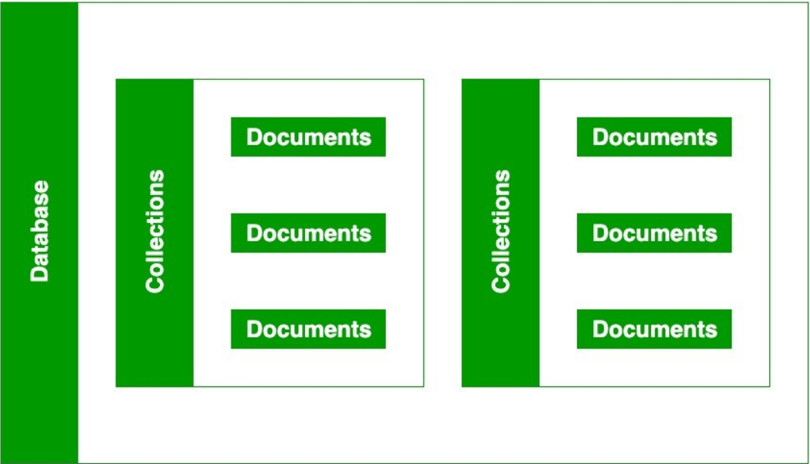
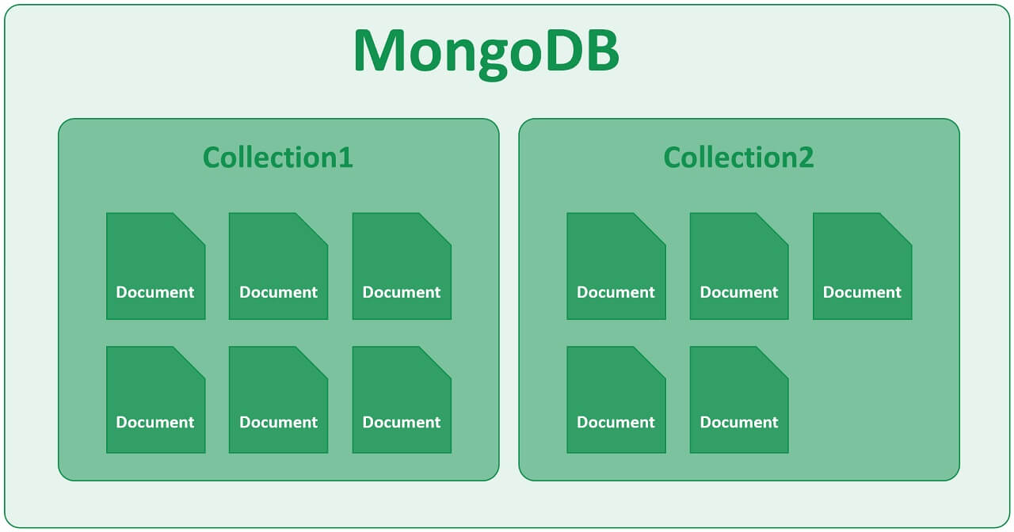

Slide 40
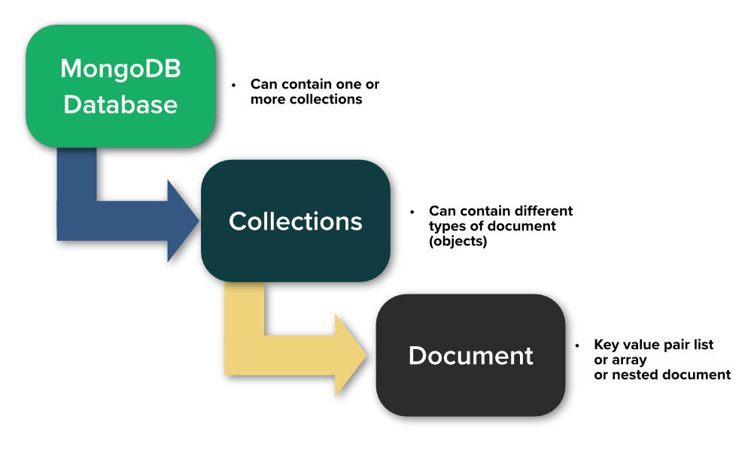

Slide 41
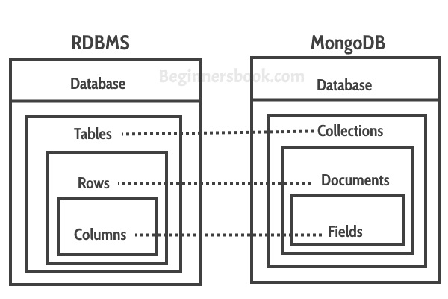
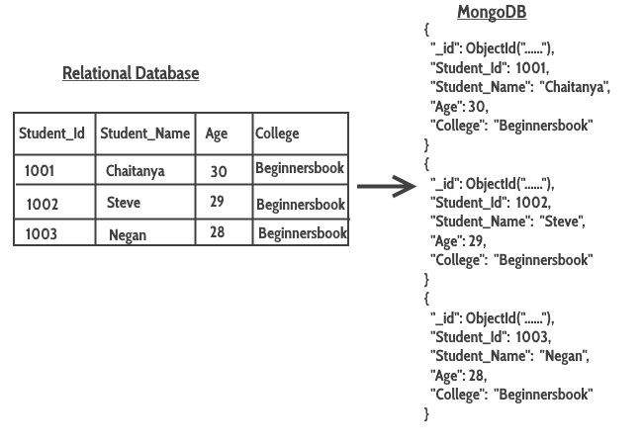

Slide 42
Data Model Design:
MongoDB provides two types of data models: — Embedded data model and Normalized / Referencing data mode.
Embedded Data Model :-
One-to-one Relationship
One-to-many Relationship
One-to-one Relationship :- one field mapped into one document.
EX 1:-
{
field1:{ },
field2:{ }
}
EX 2:-
{
field1:{ field3: { } },
field2:{ }
}

Slide 43
EX 1:- One-to-one Relationship
{
id: 01
name: “abcd”,
Age: 25,
Address: {
city: “Lucknow”,
state: “UP”,
zip: “13400”,
}
}
MongoDB Support 100 Level of Nesting.

Slide 44
One-to-many Relationship :- one field mapped into multiple document.
EX 1:-
{
field1:[ { }, { }, { } ]
}
EX 1:-
{
id: 01
name: “abcd”,
Address: [ { Add_No:1
city: “Lucknow”,
state: “UP” },
{ Add_No:2
city: “Bangalore”,
state: “Karnataka” }
]
}

Slide 45
Normalized data mode :-
In Referencing we create other collection , and add a reference .
Stu_detail
{
Id:001,
name: “abcd”,
Age: 25,
}
Address
{
city: “Lucknow”,
state: “UP”,
user_id:001
}
collection1
collection2
Reference

Slide 46
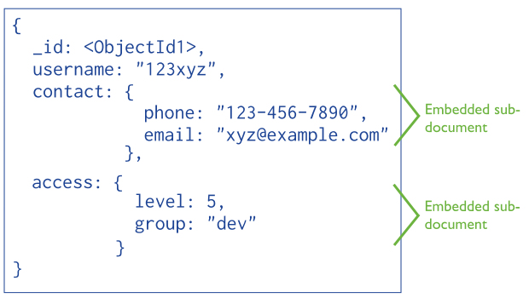
Embedded Data Model Design:

Slide 47
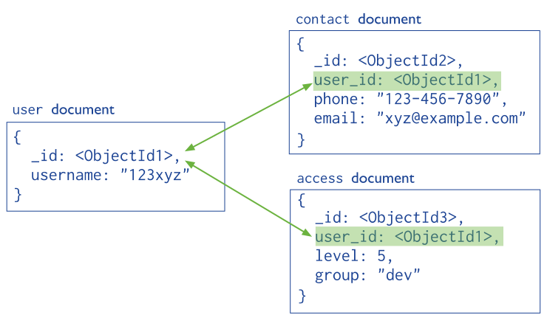
Normalized / Referencing Data Model Design:

Slide 48
Create a Database using Mongosh
After connecting to your database using Mongosh, you can see which database you use by typing db in your terminal.
If you have used the connection string provided by the MongoDB Atlas dashboard, you should be connected to the myFirstDatabase database.
Show all databases
To see all available databases, in your terminal type show dbs.
Notice that myFirstDatabase is not listed. This is because the database is empty. An empty database is essentially non-existant.
Change or Create a Database
You can change or create a new database by typing use then the name of the database.

Slide 49
Create Collection using mongosh
There are 2 ways to create a collection.
Method 1
You can create a collection using the createCollection() database method.
For eg - db.createCollection("posts")
Method 2
You can also create a collection during the insert process.
db.posts.insertOne(object)

Slide 50
Insert Documents
There are 2 methods to insert documents into a MongoDB database.
insertOne()
To insert a single document, use the insertOne() method.
This method inserts a single object into the database.
db.posts.insertOne({ title: "Post Title1", body: "Body of post.", category: "News",
likes: 1,
tags: ["news", "events"], date: Date()
})

Slide 51
db.posts.insertMany([ {
title: "Post Title 2",
body: "Body of post.",
category: "Event",
likes: 2,
tags: ["news", "events"],
date: Date()
},
{ title: "Post Title 3",
body: "Body of post.",
category: "Technology",
likes: 3,
tags: ["news", "events"],
date: Date()
},
{ title: "Post Title 4",
body: "Body of post.",
category: "Event",
likes: 4,
tags: ["news", "events"],
date: Date() } ])
insertMany()
To insert multiple documents at once, use the insertMany() method.
This method inserts an array of objects into the database.

Slide 52
Find Data
There are 2 methods to find and select data from a MongoDB collection, find() and findOne().
find()
To select data from a collection in MongoDB, we can use the find() method.
This method accepts a query object. If left empty, all documents will be returned.
db.posts.find()
findOne()
To select only one document, we can use the findOne() method.
This method accepts a query object. If left empty, it will return the first document it finds.
db.posts.findOne()

Slide 53
Querying Data
To query, or filter, data we can include a query in our find() or findOne() methods.
db.posts.find( {category: "News"} )
Projection
Both find methods accept a second parameter called projection.
This parameter is an object that describes which fields to include in the results.
Example
This example will only display the title and date fields in the results.
db.posts.find({}, {title: 1, date: 1})
We use a 1 to include a field and 0 to exclude a field.
Example
This time, let's exclude the _id field.
db.posts.find({}, {_id: 0, title: 1, date: 1})

Slide 54
Comparison Operators
$eq: Matches values that are equal to a specified value.
Example: { age: { $eq: 25 } }
$ne: Matches values that are not equal to a specified value.
Example: { status: { $ne: "A" } }
$gt: Matches values that are greater than a specified value.
Example: { age: { $gt: 18 } }
$gte: Matches values that are greater than or equal to a specified value.
Example: { age: { $gte: 18 } }
$lt: Matches values that are less than a specified value.
Example: { age: { $lt: 18 } }
$lte: Matches values that are less than or equal to a specified value.
Example: { age: { $lte: 18 } }
$in: Matches any of the values specified in an array.
Example: { status: { $in: ["A", "B"] } }
$nin: Matches none of the values specified in an array.
Example: { status: { $nin: ["A", "B"] } }

Slide 55
Logical Operators
$and: Joins query clauses with a logical AND returns all documents that match the conditions of both clauses.
Example: { $and: [ { age: { $gt: 25 } }, { status: "A" } ] }
$or: Joins query clauses with a logical OR and returns all documents that match the conditions of either clause.
Example: { $or: [ { age: { $gt: 25 } }, { status: "A" } ] }
$not: Inverts the effect of a query expression.
Example: { age: { $not: { $gt: 25 } } }
$nor: Joins query clauses with a logical NOR and returns all documents that fail to match both clauses.
Example: { $nor: [ { age: { $gt: 25 } }, { status: "A" } ] }

Slide 56
Element Operators
$exists: Matches documents that have the specified field.
Example: { name: { $exists: true } }
$type: Selects documents if a field is of the specified type.
Example: { age: { $type: "int" } }
Array Operators
$all: Matches arrays that contain all elements specified in the query.
Example: { tags: { $all: ["red", "blue"] } }
$elemMatch: Matches documents that contain an array field with at least one element that matches all the specified query criteria.
Example: { results: { $elemMatch: { score: { $gt: 80 }, grade: "A" } } }
$size: Matches any array with the number of elements specified.
Example: { tags: { $size: 3 } }

Slide 57
Update Operators
$set: Sets the value of a field in a document.
Example: { $set: { age: 30 } }
$unset: Removes the specified field from a document.
Example: { $unset: { age: "" } }
$inc: Increments the value of a field by a specified amount.
Example: { $inc: { age: 1 } }
$push: Adds an item to an array.
Example: { $push: { tags: "blue" } }
$pull: Removes all instances of a value from an array.
Example: { $pull: { tags: "blue" } }
$addToSet: Adds an item to an array only if it does not already exist.
Example: { $addToSet: { tags: "green" } }

Slide 58
Aggregation Operators
$sum: Returns the sum of numeric values.
Example: { $group: { _id: "$category", total: { $sum: "$amount" } } }
$avg: Returns the average of numeric values.
Example: { $group: { _id: null, avgAge: { $avg: "$age" } } }
$min: Returns the minimum value.
Example: { $group: { _id: null, minAge: { $min: "$age" } } }
$max: Returns the maximum value.
Example: { $group: { _id: null, maxAge: { $max: "$age" } } }

Slide 59
Update Document
To update an existing document we can use the updateOne() or updateMany() methods.
The first parameter is a query object to define which document or documents should be updated.
The second parameter is an object defining the updated data.
updateOne()
The updateOne() method will update the first document that is found matching the provided query.
Let's see what the "like" count for the post with the title of "Post Title 1":
Now let's update the "likes" on this post to 2. To do this, we need to use the $set operator.
Example
db.posts.updateOne( { title: "Post Title 1" }, { $set: { likes: 2 } } )

Slide 60
updateMany()
The updateMany() method will update all documents that match the provided query.
Example
Update likes on all documents by 1. For this we will use the $inc (increment) operator:
db.posts.updateMany({}, { $inc: { likes: 1 } })

Slide 61
Questions
Update the city of customer with customerid: 102 to "Los Angeles".
Use the $set operator to achieve this.
Increment the customerid of customer with firstname: 'Vikas' by 5.
Use the $inc operator for this.
Add a new field phone: '123-456-7890' to the customer with customerid: 100.
Use the $set operator to add this field.
Remove the state field from the customer with customerid: 102.
Use the $unset operator to remove this field.
Add the tag "premium" to the tags array of the customer with customerid: 100, but only if it doesn't already exist.
Use the $addToSet operator to add the tag.
Remove the tag "inactive" from the tags array of the customer with customerid: 102.
Use the $pull operator to remove this tag.

Slide 62
Calculate the total customerid sum of all customers.
Use the $sum operator to get the total of all customerid fields.
Find the average postalcode of customers from the India country.
Use the $avg operator to calculate the average postal code of customers from India.
Get the maximum customerid across all customers.
Use the $max operator to find the highest customerid.
Find the minimum postalcode of customers in the USA.
Use the $min operator to retrieve the smallest postal code for customers in the USA.
Calculate the total number of customers by country.
Use the $group and $sum operators to count the number of customers in each country.
Calculate the average postalcode for each country.
Use the $group and $avg operators to find the average postal code of customers for each country.
Get the minimum customerid for customers from Australia.
Use the $min operator to find the smallest customerid for customers from Australia.
Find the maximum postalcode of customers in Germany.
Use the $max operator to find the highest postal code for customers in Germany.
Calculate the sum of customerid for customers from UK and Spain.
Use the $match operator to filter customers from UK and Spain and then use $sum to get the total.
Find the average postalcode for customers in New York.
Use the $match operator to filter customers from New York and then apply $avg on postalcode.

Slide 63
Delete Documents
We can delete documents by using the methods deleteOne() or deleteMany().
These methods accept a query object. The matching documents will be deleted.
deleteOne()
The deleteOne() method will delete the first document that matches the query provided.
db.posts.deleteOne({ title: "Post Title 5" })
deleteMany()
The deleteMany() method will delete all documents that match the query provided.
db.posts.deleteMany({ category: "Technology" })

Slide 64
Aggregation Pipeline
An aggregation pipeline consists of one or more stages that process documents:
Each stage performs an operation on the input documents. For example, a stage can filter documents, group documents, and calculate values.
The documents that are output from a stage are passed to the next stage.
An aggregation pipeline can return results for groups of documents. For example, return the total, average, maximum, and minimum values.

Slide 65
$match (Filter Documents) Filters the documents based on a condition (similar to the SQL WHERE clause).
Example: Retrieve only documents where age is greater than 30.
db.users.aggregate([
{ $match: { age: { $gt: 30 } } }
])
$group (Group Documents)
Groups the documents by a specified field and can calculate aggregated values such as sum, average, count, etc.
Example: Group users by city and count the number of users in each city.
db.users.aggregate([
{ $group: { _id: "$city", totalUsers: { $sum: 1 } } }
])

Slide 66
$project (Reshape Documents)
Reshapes documents by specifying the fields to include or exclude, and you can also add computed fields.Example: Only include the name and age fields, and calculate a new field ageInMonths.
db.users.aggregate([
{ $project: { name: 1, age: 1, ageInMonths: { $multiply: ["$age", 12] } } }
])
$sort (Sort Documents)
Sorts the documents by a specified field in ascending or descending order.Example: Sort users by age in descending order.
db.users.aggregate([
{ $sort: { age: -1 } }
])

Slide 67
$skip (Skip Documents)
Skips the first N documents in the result set.Example: Skip the first 3 users in the result set.
db.users.aggregate([
{ $skip: 3 }
])
$unwind (Deconstruct Array Fields)
Deconstructs an array field into multiple documents, where each document contains a single value from the array.Example: Assume each user document has an array of hobbies. Unwind the hobbies array so each document represents a single hobby.
db.users.aggregate([
{ $unwind: "$hobbies" }
])

Slide 68
$lookup (Join Documents)
Performs a left outer join between two collections.Example: Join the users collection with the orders collection to show the orders of each user.
db.users.aggregate([
{ $lookup: {
from: "orders",
localField: "_id",
foreignField: "userId",
as: "userOrders"
}
}
])
$addFields (Add/Modify Fields)
Adds new fields or modifies existing fields in the documents.Example: Add a new field fullName by concatenating firstName and lastName.
db.users.aggregate([
{ $addFields: { fullName: { $concat: ["$firstName", " ", "$lastName"] } } }
])

Slide 69
Question for Aggregative pipeline
Calculate the total sale price of all type.
Find the average rating of products by category.
Get the total discount offered on each product.
Find the top 3 highest rated products.
Find the total number of products in each sub-category.
Find the average sale price of products by brand.
Get the product with the maximum discount (difference between market price and sale price)

Slide 70
Indexing
Primary Index: Created on the _id field by default. This is a unique index for every document, which helps MongoDB quickly locate documents by their unique ID.
Single Field Index: Created on a single field to improve queries that only involve that field.
Compound Index: Created on multiple fields, enabling more efficient querying on combinations of those fields.
Multikey Index: Created on array fields to optimize queries involving array values.
Text Index: Used for text search, allowing search within string fields for words or phrases.

Slide 71
1. Creating a Single Field Index
Suppose we frequently query the collection by age. We can create an index on the age field like this:
db.students.createIndex({ age: 1 })
Here:
age: Field to be indexed.
1: Specifies ascending order (use -1 for descending).
2. Creating a Compound Index
If we often query students by both grade and age, we can create a compound index:
db.students.createIndex({ grade: 1, age: 1 })
This compound index will optimize queries that filter by both grade and age, such as:
db.students.find({ grade: "A", age: 23 })

Slide 72
3. Creating a Multikey Index
If we want to search within the subjects array, MongoDB will create a multikey index automatically:
db.students.createIndex({ subjects: 1 })
This index allows efficient queries on the subjects array, like:
db.students.find({ subjects: "Math" })
4. Creating a Text Index
To enable text search on the name field, you can create a text index:
db.students.createIndex({ name: "text" })
This allows you to search for documents containing specific words or phrases in name:
db.students.find({ $text: { $search: "Alice" } })

Slide 73
Viewing Indexes
You can view all indexes in a collection using:
db.students.getIndexes()
Dropping an Index
To remove an index:
db.students.dropIndex("index_name")

Slide 74
Query by a Field in an Embedded Document
In MongoDB, an embedded document is a document nested within another document. You can query by a field within an embedded document by using dot notation, which allows you to access the nested fields directly
Finding a Document by City
Let’s say you want to find students who live in "New York." You would write the query like this:
db.students.find({ "address.city": "New York" })
“address.city": Refers to the city field inside the address embedded document.
"New York": The value you are looking for.

Slide 75
What is the total sale amount in the document?
How can we get the names of all products in this sale?
What is the total quantity of items sold in this sale?
How can we extract the customer's contact information?
How can we find the total value (quantity * price) of each product in this sale?
Who is the salesperson responsible for this sale?
What is the total revenue generated from both sales?
How can we get a list of all customers who made a purchase?
Get a list of all the customers and their total purchased amount.
Get the total quantity sold for each product across all over the sales.
Retrieve the top 3 customers by the total spending.

Slide 76
Auto Shading
Sharding is a method for distributing data across multiple machines. MongoDB uses sharding to support deployments with very large data sets and high throughput operations.
Database systems with large data sets or high throughput applications can challenge the capacity of a single server. For example, high query rates can exhaust the CPU capacity of the server. Working set sizes larger than the system's RAM stress the I/O capacity of disk drives.
There are two methods for addressing system growth: vertical and horizontal scaling.
Vertical Scaling involves increasing the capacity of a single server, such as using a more powerful CPU, adding more RAM, or increasing the amount of storage space. Limitations in available technology may restrict a single machine from being sufficiently powerful for a given workload. Additionally, Cloud-based providers have hard ceilings based on available hardware configurations. As a result, there is a practical maximum for vertical scaling.
Horizontal Scaling involves dividing the system dataset and load over multiple servers, adding additional servers to increase capacity as required. While the overall speed or capacity of a single machine may not be high, each machine handles a subset of the overall workload, potentially providing better efficiency than a single high-speed high-capacity server. Expanding the capacity of the deployment only requires adding additional servers as needed, which can be a lower overall cost than high-end hardware for a single machine. The trade off is increased complexity in infrastructure and maintenance for the deployment.

